Slide 1

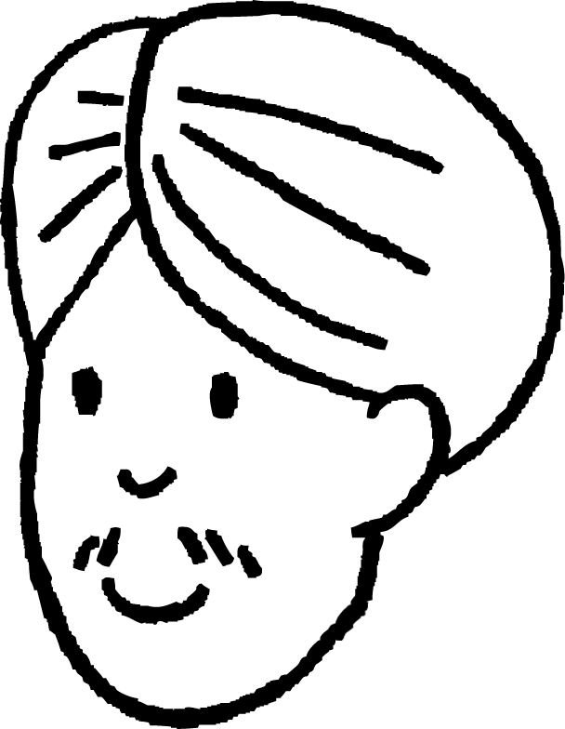
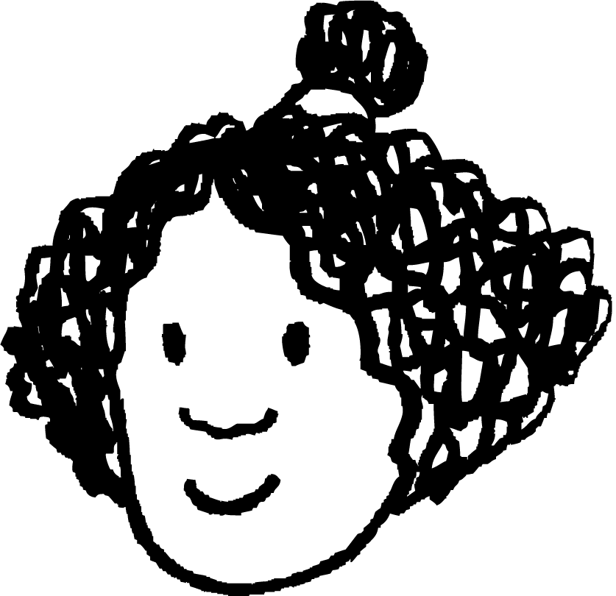







Checking understanding of sequences
Task A: Sequences with a constant additive pattern
These pupils are making number patterns from a rule
Aisha says any number, Andeep adds a number to it. Each pupil then adds the same number Andeep added. For each question, justify your answer.
If Aisha says 6 and Andeep says 10, what will Izzy say?
If Aisha says 6 and Andeep says 10, what will Sofia say?
After a different starting number Sam says 17 and Alex says 19. What did Aisha say?
If Aisha says 4 to start and Jun says 40 What will Lucas say?
Aisha starts with 10, only Lucas’ number is another integer, what could Andeep have said?
Aisha
Andeep
Izzy
Jacob
Jun
Lucas
Laura
Sam
Alex
Sofia
Izzy will say 14 as Andeep added 4 to Aisha’s number and 10 + 4 = 14
Sophia will say 42 as 4 will have been added another 8 times after Andeep says 10
Aisha said 3. Each pupil is adding 2. Subtracting 2 seven times from 17 is 3
Lucas says 49. A number has to be added 4 times to get from Aisha to Jun. The difference between their numbers is 36 so each pupil adds 9
Andeep could have added any number which is a multiple of 0.2
e.g 10 + 0.4 = 10.4 or 10 + 5.6 = 15.6 or 10 + 3.2 = 13.2
There are 5 additions between Aisha and Lucas if Lucas said 11 then
1 ÷ 5 = 0.2
If Lucas said 12 then 2 ÷ 5 = 0.4

Slide 2

Checking understanding of sequences
Task B: Sequences with a constant multiplicative pattern
Sort these sequences into the correct column
Sequences with a constant additive relationship | Sequences with a constant multiplicative relationship
5, 10, 15, 20, …
1, 2, 4, 8, …
5.7, 8.1, 10.5, 12.9, …
3, 30, 300, 3000, …
1.5, 0.5, -0.5, -1.5, …
48, 24, 12, 6, …
6, 48, 90, 132, …
3, -6, 12, -24 …
0.5, 1.5, 4.5, 13.5 …
2) Find the missing numbers in these sequences with constant multiplicative patterns.
6, 12, 24, 48, …
5, 30, 180, 1080, …
160, 80, 40, 20, …
0.3, -3, 30, -300, …
e) 7, 21, 63, 189, …
f) 1, 0.2, 0.04,0.008, …
g) 0.4, 8, 160, 3200,64 000, …
h) 4.5, 6, 8, , …
Mathematics in Education and Industry
v2.2

